Slide 1

NoTeamName
/ Vimal Prakash / Elakkuvan Rajamani / Ezhilarasan Rangan / Ramkumar Nambhi

Slide 2

Agenda
## Introduction ## Reasons to do it ? ## Working Principle ## How we resolve ? ## Graphe{Netor} PagesPipeline
## Demo
## Future Plans

Slide 3
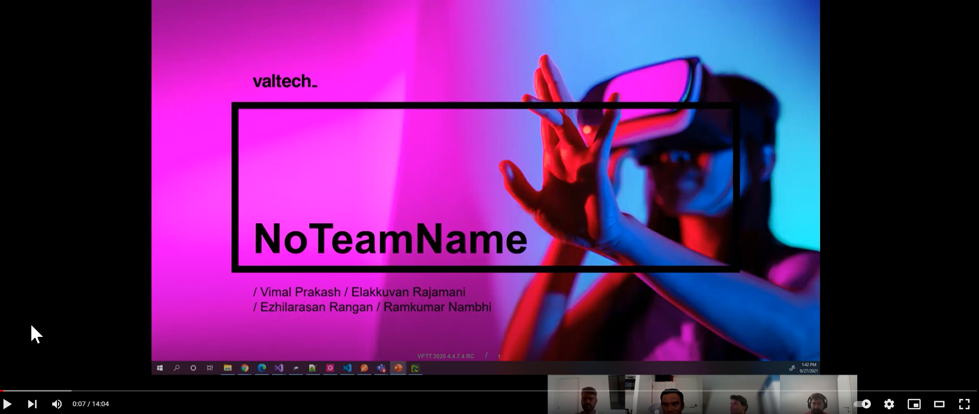
Watch Video here
https://www.youtube.com/watch?v=v2btkQxBntc

Slide 4

Introduction

Slide 5
#OneValtech
/ What makes #Valtech standalone is its values - Share - Dare - Care,
/ We the NoTeamName Dared to create ‘a framework’ that can be shared across all streams & regions to create collaborative platforms (blogs/knowledge bases/document repository/forums) as we care for each other..!!!
/ After-all We're #OneValtech

Slide 6
#Graphe{Netor}
/ Our 'Graphe{Netor} framework generates Sitecore sites & deploys to Netlify' within seconds.

Slide 7

Reason to do it ?
Multiple Static Site Generator available for JSS <Next/Nuxt/Gatsby> but none for Rendering host running on asp.net core.
Ability to spin up futuristic sites quickly ! Blogs/Knowledge Bases/Document Repos etc
High availability and increased Performance : Much needed when working as #OneValtech from different regions

Slide 8
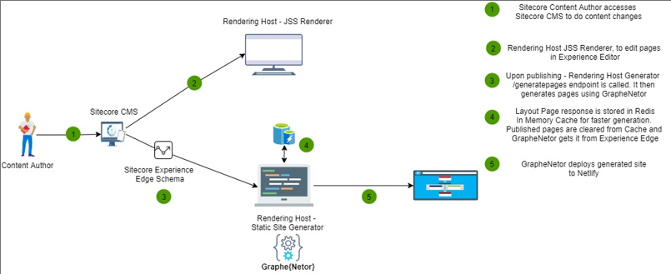
#Working Principle

Slide 9
#How we resolve ?
Edit Content | Publish Content | Graphe{Netor} – Static Site Generation | Deploy to Netlify ( for CDNs)
/ Authors creates or edits content in Sitecore CMS | / Authors Publish the content and it triggers the Static Site Generation in RenderingHost | / Site is generated using “PagesPipeline” that generates site using GraphQL queries / It is built using Experience Edge scheme | / After static site is generated, it is deployed to Netlify

Slide 10
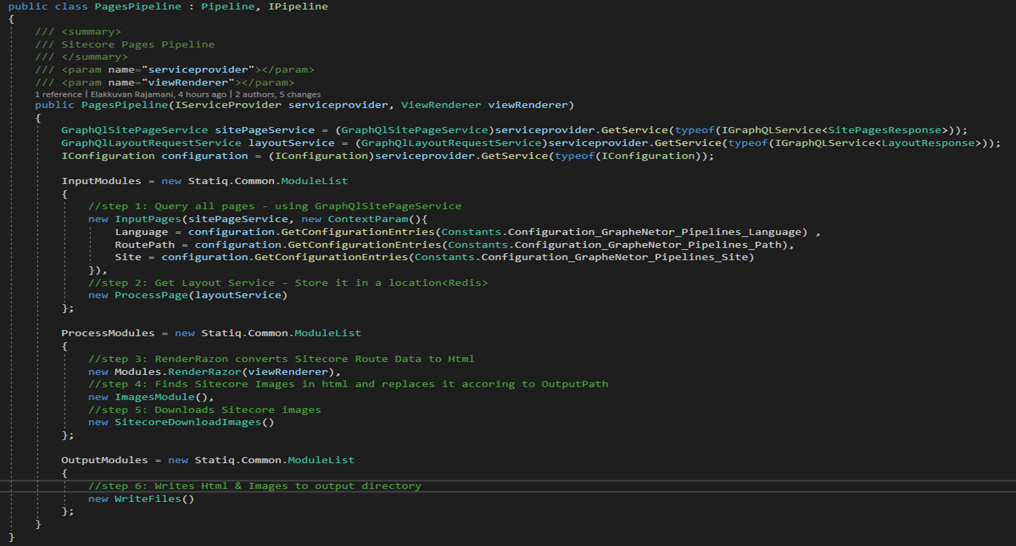
#Graphe{Netor} PagesPipeline

Slide 11

Demo

Slide 12
Future Plans
Enhancing Graphe{Netor} and releasing it as a NuGet Package
Supporting multiple CDNs
Azure
GitHub Pages etc.,

Slide 13

Thank You

